Slide 1
Gender, Disability and Communications Guidance Notes
Health Security Initiative
Information for partners:
Wednesday, December 2, 3.00 OR Thursday December 3, 10.00 AEDS

Slide 2
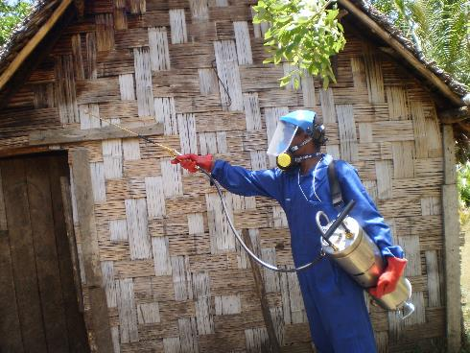
Agenda:
Welcome and Introductions | 5 min
Gender Guidance Notes Intro to the gender guidance notes Example: Gender sensitive programming and health security Hunter New England Health (Field Epidmiology and Rapid Response Team Training in PNG and Solomon Islands) | 5 min 10 min
Disability Guidance Notes Intro to the disability guidance notes Activity: Mentimeter What is your project doing/ will your project do to address disability inclusion in design or delivery? | 5 min 10 min
Communication Intro to the Centre for Health Security’s communications strategy Activity: Mentimeter Tweet an update about your project. What is a great story that your project would be interested in publishing as a case study? | 5 min 10 min
Questions | 10 min

Slide 3
Housekeeping
Housekeeping
Please…
Mute yourself
Go off video to save bandwidth
All documents are on our new monitoring and evaluation resources hub
https://indopacifichealthsecurity.dfat.gov.au/monitoring-and-evaluation-resources-hub
If CHS internet cuts out…
The meeting will continue (no one will be “booted off” zoom)
We have backup options, but may not be able to join with video on backup options
If we move to a backup option without video:
The slides are uploaded to the meeting invite, so that you can follow along
A backup presenter will inform the meeting that we have moved to an audio-only option
Please wait 1-2 minutes for the presenter to re-join and continue presenting

Slide 4
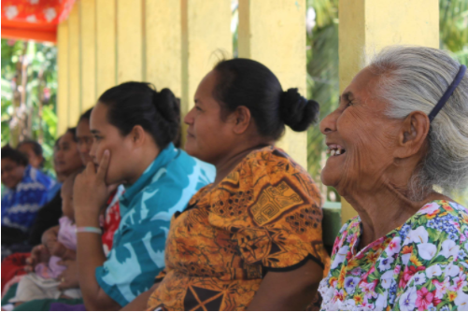
We have 10 minutes set aside for questions at the end of the presentation
Utilise the chat function: to begin with we ask that all questions be typed into the chat function
If time and size of meeting allows, we will expand to have people asking questions in person
Questions will be collated and answered at the end of the presentation
In particular, please consider the following questions:
What extra information would you like?
What is still unclear?
Housekeeping - Questions

Slide 5
Welcome and Introductions

Slide 6
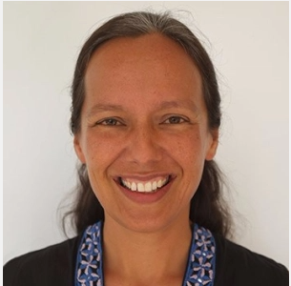
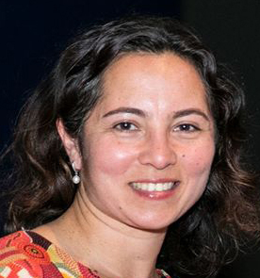
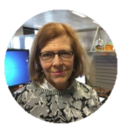
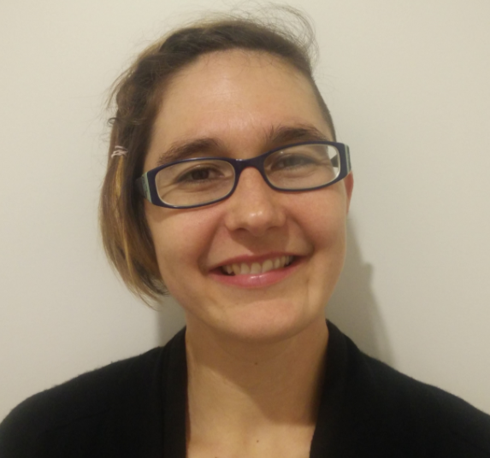
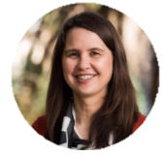
Introductions
DFAT Presenters
Partner Presenter
Director,
Gender Equality Branch,
DFAT
Communications Adviser,
Centre for Health Security,
DFAT
Epidemiologist
Hunter New England Health
ADDEPt and FEiA
Disability Inclusion Adviser, DFAT
Annemarie Reerink
Larissa Burke
Amita Monterola
Rachel Mather
Monitoring and Evaluation Team
Monitoring and Evaluation Team,
Centre for Health Security, DFAT
Monitoring and Evaluation Advisers
Irene Wettenhall
Mica Hartley
Kathryn Dinh
Keryn Clark

Slide 7
Gender and Health Security

Slide 8
Gender Analysis
Conducting a gender analysis helps to:
Investigate biological and social differences between men and women
Allow program design to respond to these differences
Allow programs to respond more effectively to needs of men and women
Reduce risks of unintended negative consequences for women and girls
16 days of activism against gender-based violence: 25 Nov – 10 December

Slide 9
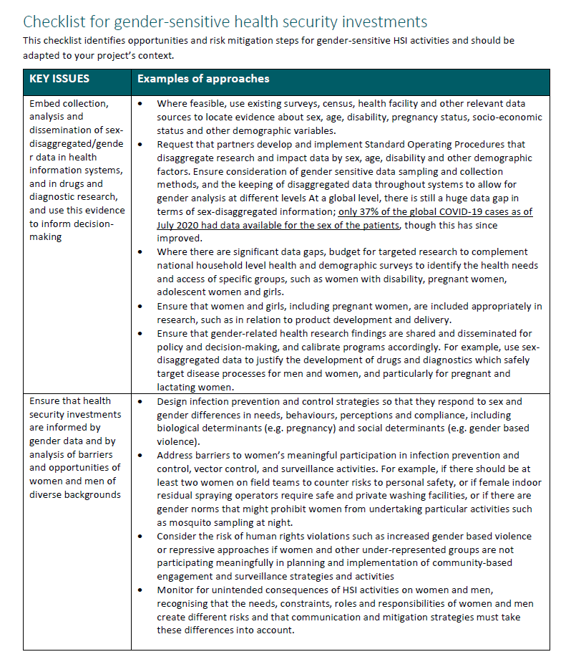
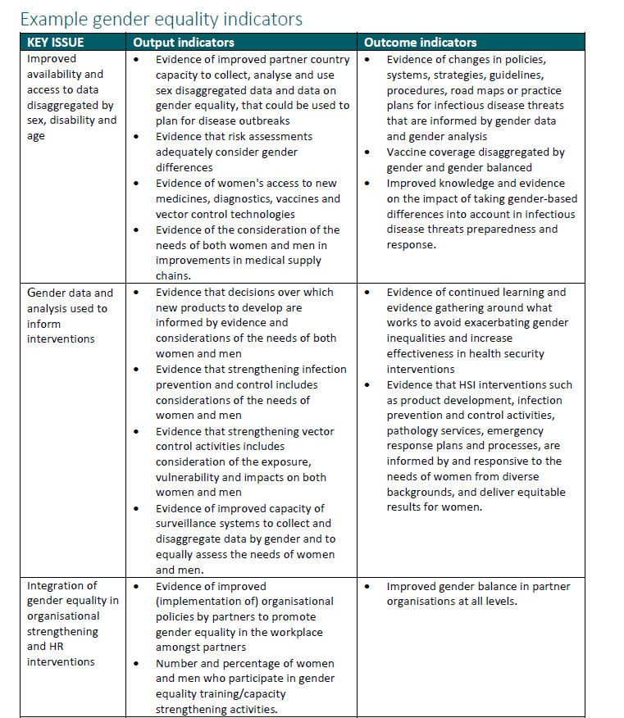
Steps for gender-sensitive programming
The Centre’s Guidance note contains these steps, key guiding questions and suggested monitoring and evaluation indicators.
Ensure data and evidence is available
Collect data/evidence in gender analysis and ensure design responds to the findings of gender analysis
Pay attention to the ways in which organisations are gendered and the need for gender training
Engage meaningfully with women’s organisations and ensure gender balance in decision making

Slide 10
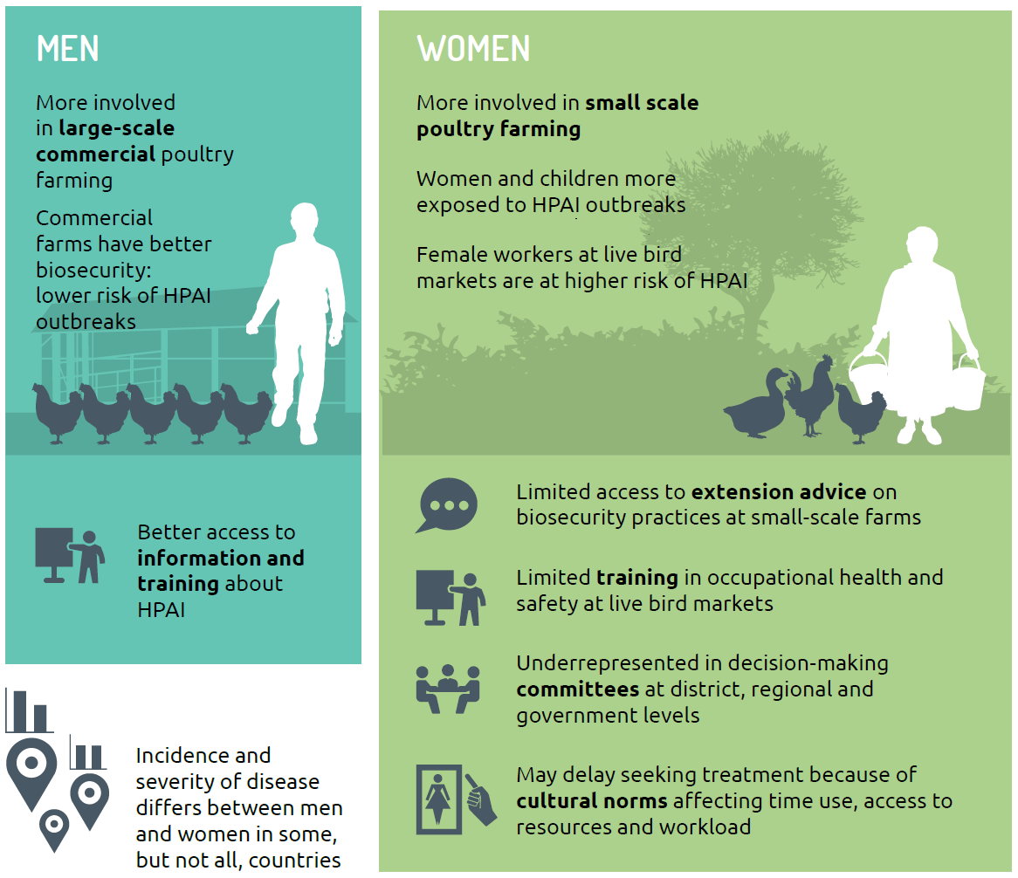
Gender in Health Security
Gender affects health risks, behaviours, access to services and health outcomes
Disease outbreaks affect women, men, girls, boys and people with non-binary gender identities differently

Slide 11
Example: Gender and Health Security Hunter New England Public Health Department (ADEPPt and FEiA projects)

Slide 12
Notes:
Before I start I want to reiterate that we have permission to use all of the photos included in this presentation. None of the fellows who I talk about have their photos presented.
HNE has been working in the FETP space for about 8 years now. Our Field Epidemiology in Action project could be categorised as a workforce capacity development project. We primarily develop workfprce that in 2 ways:
The first is through building epidemiological capacity and abilities to detect and respond to outbreaks through intermediate and advanced FETPs. In the context of Papua New Guinea, the intermediate program is FETPNG, and this generally enrols Health Extension Officers or people in similar roles
The second way is through building technical, leadership and mentoring capacity amongst faculty on our programs

Slide 13
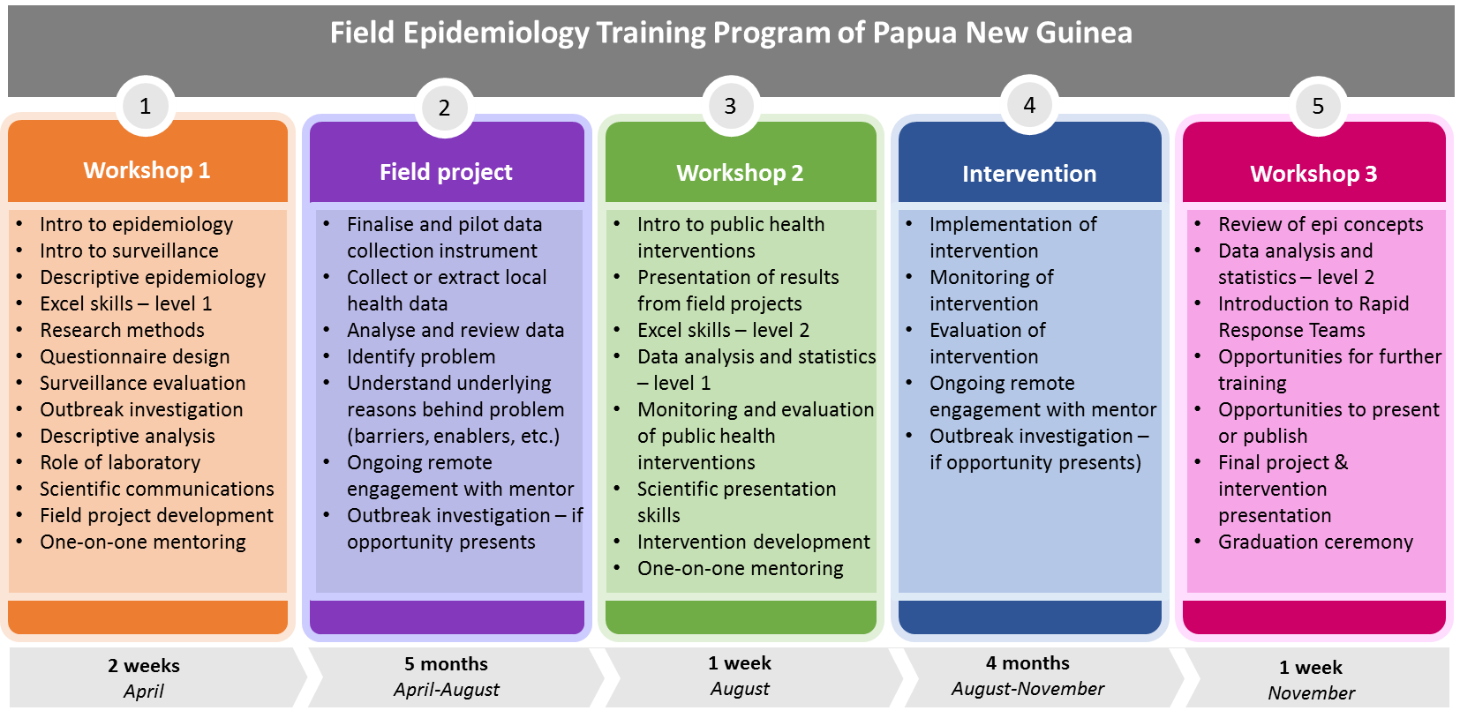
FETPNG delivery structure
Notes:
And for a bit of context as to what that actually looks like:
Our programs are normally implemented in three workshops with fellows travelling from far and wide to attend for one to two weeks. Fellows are paid a per diem for each day that they are based at the training venue, and generally share accommodation with one other fellow of the same sex. The expenses for travel and accommodation are paid by the program. For faculty and fellows from Port Moresby, a per diem is only provided if the location of the training venue is outside of the National Capital District, which generally sees workshops held just outside the boundaries. The running time of the average day is 8am to 5pm, with breaks in between sessions. We sometimes run extra sessions on weekends for deeper dives into Excel, and often there will be mentoring of an evening.
Following the first and second workshops, fellows return to their workplaces to implement, in the first period an epidemiological project, and in the second period an intervention project. They do this on top of their normal work, although its communicated to their managers that their projects should take, on average, around a third of their normal work time.
While we aren’t aware of other FETPs that include a field-based intervention project, this format of intensive training in workshops combined with field-based time is the global norm.
In terms of the national and indeed most of the international faculty – everyone holds full-time work in health departments, and support to the program is offered in-kind, with travel related expenses reimbursed. Alongside attendance of four weeks of workshops each year per program, the faculty spend significant time mentoring fellows while they complete their field-based projects. Of the five core National Faculty, three are women. It’s worth noting that one is currently the Leader of the National Control Centre for the COVID response, one completed the Thai FETP program after showing her leadership quality in the FETPNG program, and one completed a Public Health Leadership Program with WPRO in the Philippines last year.

Slide 14
FETPNG Fact Check: numbers game
Notes:
Since its inaugural year in 2013, FETPNG has graduated 93 fellows. While only 36% of fellows enrolled in the program were female, they had better outcomes than their male counterparts, and so comprise 40% of graduates. Just 12% of female participants did not graduate, compared to 26% of male enrolments. There are a whole lot of reasons that we can speculate why this might be the case, but it’s a little study unto itself.
(PAUSE)
For this graph, the higher the number on the y-axis, the higher the ratio of female to male participants.
From a gender standpoint, 2017 was arguably the best year of the program when the ratio of female to male enrolments and graduates was equal, but 2014 is notable for having more female enrolments and equal graduates to males, and 2016 stands out for its higher ratio of female graduates. Things have gone downhill since 2017, but females have still out performed their male counterparts. In fact, from 2015 onwards, all females who have enrolled in the program have completed it. While our cohort is relatively small to make generalisations, it does seem that women are a better investment than men, at least in terms of graduates.

Slide 15
Notes:
But we understand that equality is much more than a numbers game.
(pause)
Last year when there were just two female fellows enrolled in the intermediate program, in his opening remarks at the first workshop, the Director of Public Health noted the disparity but urged the women to represent their gender well so that more women may follow.
A couple of days into the program, we had the surprise pleasure of meeting the toddler and husband of one of the female fellows. She explained she had to bring her little one to training as she was still breastfeeding, and her husband had to come to watch the child through the day.
And one day after that, we were called to a brief faculty meeting to discuss a problem between the two female fellows. The other female participant was, understandably, uncomfortable sharing a room with another woman’s husband and child. And it had practical implications too – there was not enough space or quiet to study in the room, and now her sleep was being disrupted by the child. After a couple of the local female faculty consulted with the family, the husband and child elected to stay with wantok in Port Moresby, and he brought the toddler back for time with Mum during the breaks.
Meanwhile, we noticed that one of the female faculty was arriving late and leaving the workshop early. We asked one of the other faculty about this, who explained that as our friend was Port Moresby based – and the workshop was, quite unusually, being held in POM – there was an expectation that she was home at a reasonable time to complete domestic duties.
So within the course of a few days, we saw that there were really high expectations on the outcomes of female participants, but we also had a sense of some of the unique considerations that impacted how people participated in the program, as either a faculty or fellow, and at what personal and financial cost.

Slide 16
Notes:
We broached the subject with PNG faculty like Rosheila and Bethseba, pictured, to discuss what a program might look like if it could be delivered in a way that really considered the unique needs of women. And while we generated a few ideas, it was clear that we really needed to understand the experiences of women in order to make evidence-based recommendations. The workshop that catalysed conversation was in April last year, and thankfully we were able to include related activities into our Field Epi in Action proposal submitted the next month.
We are in the process of developing a gender analysis that will take a deeper look at if and how Field Epidemiology Training in PNG effects women. Similar to our FETPs, we are approaching this at two levels:
The first is through understanding the experiences of women as they engage in the program in order to produce recommendations that optimise participation, and support the safety and wellbeing of women engaged in FETP
The second is through developing the research capacity of our female faculty, who are co-designing the study, and will be both participants and researchers. While they will get the opportunity to share their own experiences of contributing to the program, they will also lead interviews and potentially focus groups with fellows. Together we will use the findings to make recommendations to the National Department of Health on how to optimise female participation, and eventually will implement, monitor and evaluate adaptations made to the delivery of the program. We will share learning with the new Solomon Islands FETP, and engage them in thinking through similar processes, adapting to context. And given that, to the best of our knowledge, there has not yet been an analysis of gender amongst FETPs globally, we plan to share our process and learning far and wide.

Slide 17
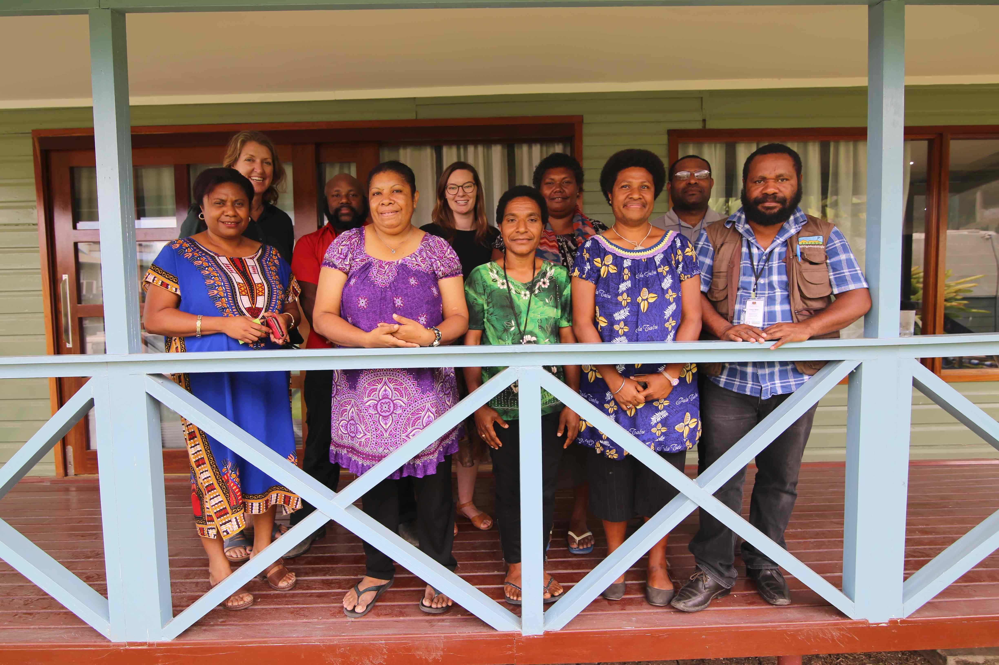
Notes:
We also want to recognise the work of fellows, female and male, wo have frequently identified women’s health as the most pressing issue to address within their communities. Interestingly, their studies frequently identify intersections of male behaviours and attitudes, and addressing these ultimately leads to improvements for women and often children. Over the years, topics have included:
Identifying unmet needs for family planning amongst women
Numerous studies looking to understand the barriers and enablers of supervised delivery
Early screening and detection of cervical cancer
Assessing access and adherence to post-exposure prophylaxis amongst survivors of sexual violence
Supporting contraception access and sexual and reproductive health rights counselling for teenagers

Slide 18
Notes:
The other key component of our gender work in the Field Epi in Action project is through coaching female faculty in the Pacific. To date, three of the female international faculty working on the project have completed the Dattner Group’s Compass Flagship Leadership Course for Women, which we can’t recommend more highly. This course emphasises the use of coaching to support women to identify their strengths and challenges in leadership so that they can consciously determine what leadership will look like for them, as well as developing coaching skills to support the projects of their peers. These processes and tools will be contextualised for our faculty in PNG and Solomon Islands. Once in-country program delivery is possible, female faculty who wish to undertake similar processes will be coached by the international faculty who have undertaken Compass. And we completely recognise that sometimes these special programs for marginalised groups can present an additional time burden, so we will be consulting openly with women participating in these leadership processes to identify mechanisms that are engaging, appropriate and convenient.
We’re really excited to meaningful engage of women’s experiences in our programs, and we’re also keen hear your thoughts and feedback about our approach to gender.

Slide 19
Disability Inclusion

Slide 20
Disability Inclusion in Health Security
PEOPLE WITH DISABILITIES
Experience barriers accessing health services and public health information
Are often at a higher risk of acquiring infectious disease due to:
Living arrangements – more likely to live in poverty and crowded conditions
A lack of adequate or accessible water, sanitation and hygiene (WASH) infrastructure
Lower access to vaccines
Challenges in infection prevention and control, e.g. for those relying on personal assistance or sign language interpretation
International Day of People with a Disability
December 3

Slide 21
Disability Inclusion in Health Security
Disability Inclusion in programming
Disability inclusion is a process and an outcome
Process = Support the active and central role of people with disabilities in contributing to their own development
Outcome = Identify and remove barriers to inclusion
https://www.fijitimes.com/empower-pacific-concerned-with-mental-health-stats-in-schools/

Slide 22
Example barriers and solutions for people with disabilities
Infectious disease risk factors and barriers for people with disabilities
Potential Solutions
Health information is not accessible
Use multiple health and risk communication strategies and formats (for example, e.g. to ensure access for people with communication impairments)
Difficulty travelling and accessing a health facility
Ensure that health facilities have accessible buildings, pathways, toilets and equipment
Consider mobile clinics to reach people
Negative attitudes and low knowledge of rights and health needs from healthcare providers
Implement training programs and policies for health workforce and society to reduce stigma and discrimination experienced by people with disabilities
Unaffordable health services
Offer free or subsidised services for at-risk groups, including people with disabilities

Slide 23
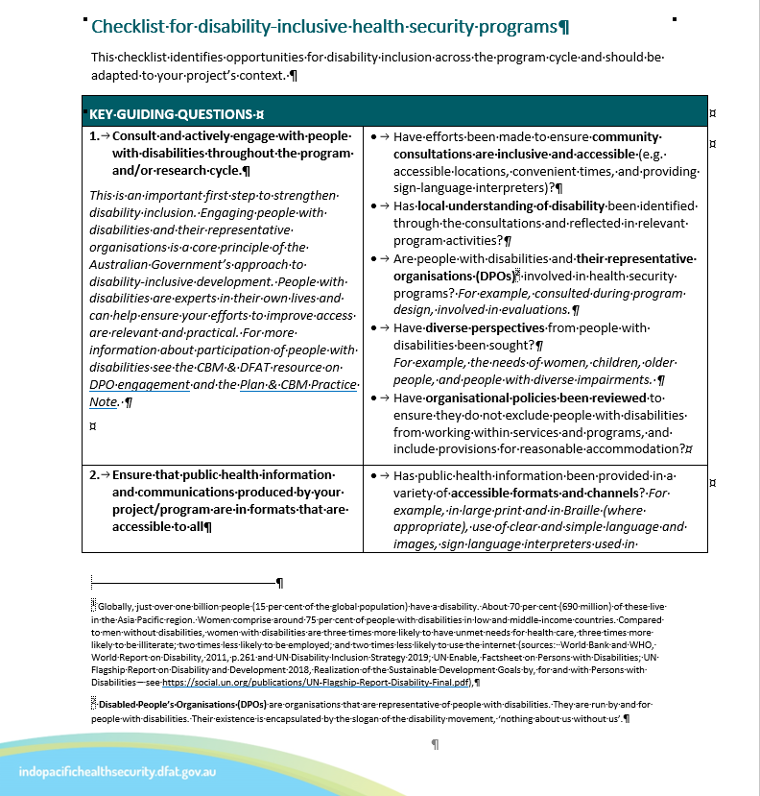
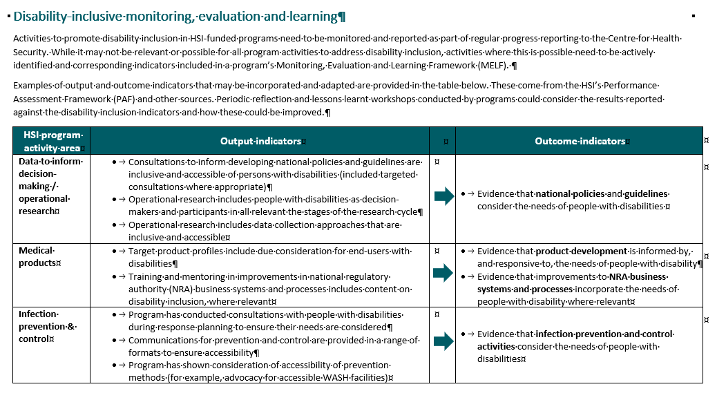
Steps for Disability Inclusion in programming
The Centre’s Guidance note contains these steps, key guiding questions and suggested monitoring and evaluation indicators.
Consult and actively engage with people with disabilities throughout the program and/ or research cycle.
Ensure that public health information and communications produced are in formats that are accessible to all.
Ensure that any training addresses disability inclusion.
Embed disability in health information management and surveillance systems

Slide 24
Mentimeter

Slide 25
Mentimeter: https://www.menti.com/
Code: 67 35 18 3
Instructions:
Mentimeter Question:
Q1: What is your project doing/ will do to address disability inclusion in design or delivery?
Tip:
Remember the steps for disability inclusion:
consult and engage;
public health information and communications;
training;
health information systems

Slide 26
Communications

Slide 27
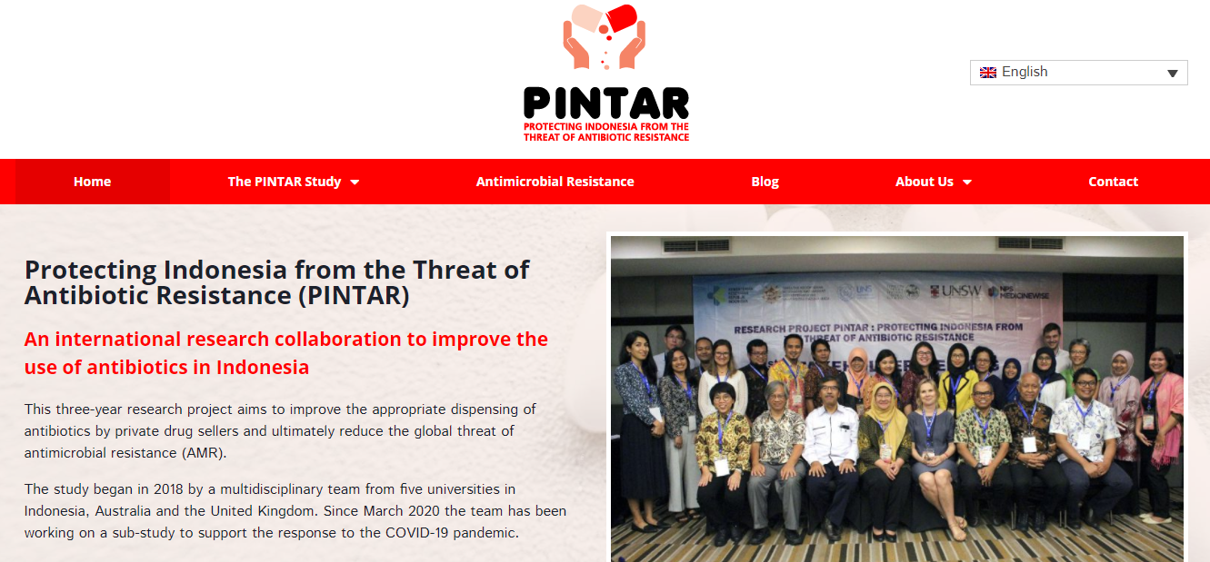
Website
www.pintarstudy.org

Slide 28
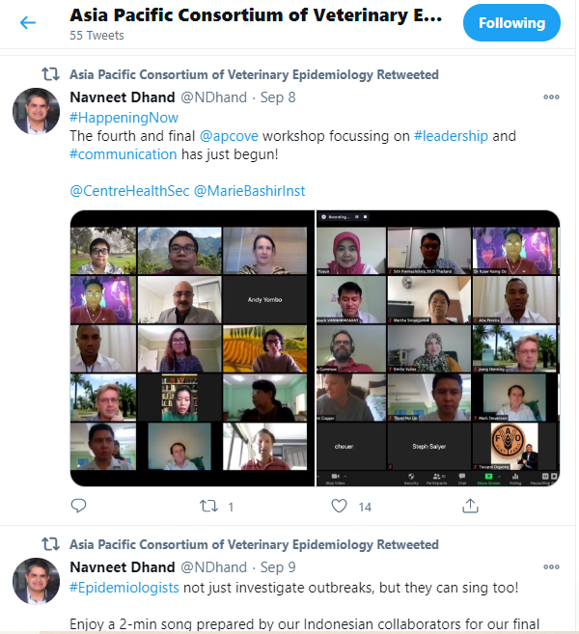
Twitter
Twitter.com/apcove

Slide 29
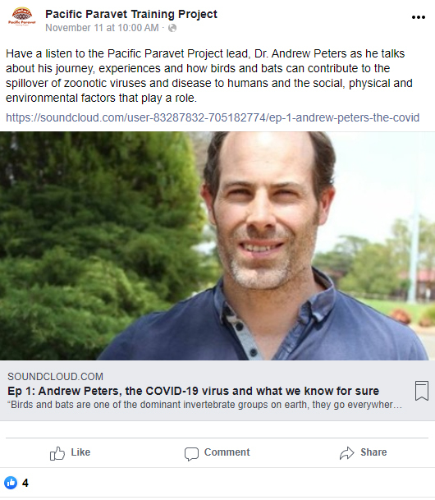
Facebook
Facebook.com/pacificparavettrainingproject

Slide 30
Mentimeter -

Slide 31
Mentimeter: https://www.menti.com/
Code: 26 13 63 0
Instructions:
Mentimeter Question:
Q1: Tweet an update about your project – please include your project’s name.
Tip:
Tweets should be two sentences that capture the reader’s attention with the most interesting aspect or exciting results from your work.

Slide 32
Mentimeter: https://www.menti.com/
Code: 26 13 63 0
Instructions:
Mentimeter Question:
Q2: What is a great story that your project would be interested in publishing as a case study? Please include your project’s name.
Tip:
Case studies work best when they showcase changes that were only possible because of your work and bring in a human interest element.
Instructions:

Slide 33
Questions

Slide 34
Questions:
This is a time for us to answer the questions you have put in the chat function. There’s still time to put a number of questions in!
We would also like to hear from you (in the chat function)
What extra information would you like?
What is still unclear?

Slide 35
Wrap-up: Next steps
Check out our new monitoring and evaluation resources hub
https://indopacifichealthsecurity.dfat.gov.au/monitoring-and-evaluation-resources-hub
Further questions – contact either your program managers or the Centre’s Monitoring and Evaluation team:
Mica (Mica.Hartley@dfat.gov.au)
Irene (Irene.Wettenhall@dfat.gov.au)
For Communications questions, or if you are interested in working with the Centre to publish one of your stories, contact our Communications Adviser:
Amita Monterola (Amita.Monterola@dfat.gov.au)
Next Monitoring and Evaluation meeting:
Wednesday Feb 10, 3.00 and Thursday Feb 11, 10.00
Topic: Reporting

