Slide 1
Reporting for the Health Security Initiative
Health Security Initiative
Information for partners:
Wednesday, February 3, 3.00 OR Thursday February 4, 10.00 AEDS

Slide 2
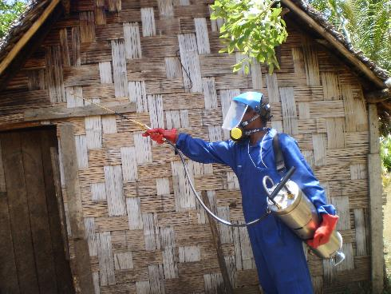
Agenda:
Welcome and Introductions | 5 min
Logistics What is due? When is it due? Where can I find it? | 10 min
How do I report? Smartygrants Demo (spoiler alert: reporting will be done through Smartygrants | 10 min
What information do I need to report? Recap of key points for reporting | 5 min
Useful lessons on reporting CHS Monitoring and Evaluation Advisors | 10 min
Q and A General Q and A Feed back from partners on reporting in previous years | 20 min

Slide 3
Housekeeping
Housekeeping
Please…
Mute yourself
Go off video to save bandwidth
All documents are on our new monitoring and evaluation resources hub
https://indopacifichealthsecurity.dfat.gov.au/monitoring-and-evaluation-resources-hub
If CHS internet cuts out…
The meeting will continue (no one will be “booted off” zoom)
We have backup options, but may not be able to join with video on backup options
If we move to a backup option without video:
The slides are uploaded to the meeting invite, so that you can follow along
A backup presenter will inform the meeting that we have moved to an audio-only option
Please wait 1-2 minutes for the presenter to re-join and continue presenting

Slide 4
We have 20 minutes set aside for questions at the end of the presentation
Utilise the chat function: to begin with we ask that all questions be typed into the chat function
If time and size of meeting allows, we will expand to have people asking questions in person
Questions will be collated and answered at the end of the presentation
In particular, please consider the following questions:
What extra information would you like?
What is still unclear?
Do you have any feedback for us on reporting you have completed for us already?
Housekeeping - Questions

Slide 5
Welcome and Introductions

Slide 6
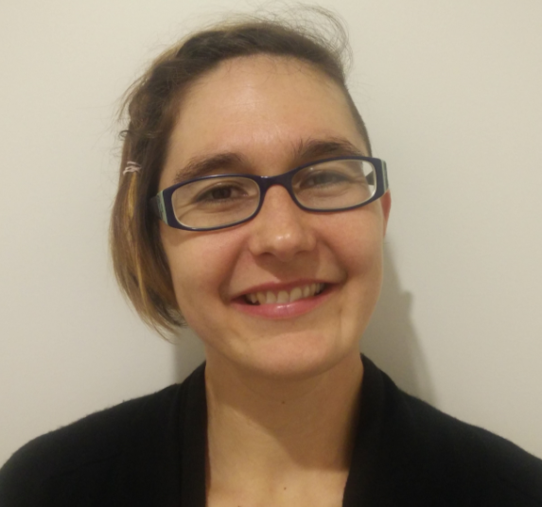
Introductions
Monitoring and Evaluation Team
Monitoring and Evaluation Team,
Centre for Health Security, DFAT
Monitoring and Evaluation Advisers
Irene Wettenhall
Mica Hartley
Kathryn Dinh
Keryn Clark

Slide 7
Logistics

Slide 8
What do I need to report and when - 2021
Item | Period that report will cover | Due Date
Annual Progress Report, including Expenditure Update | Retrospective: Jan 2020 (or start of project to Jan 2021) | March 17, 2021
Annual Workplan | Prospective: Jan 2021- Dec 2021 | March 17, 2021
6 monthly progress update and budget update (PIDP/ APPIDAR partners only) | Retrospective: Feb 2021- July 2021 | Varies, from 17 August 2021 – 17 October, 2021
Short draft workplan | Prospective: Jan 2022 – end project (June 2022) | Dec 1, 2021

Slide 9
What do I need to report and when - 2022
Item | Period that report will cover | Due Date
Annual Progress Report, including Expenditure Update | Retrospective: Feb 2021- Jan 2022 | Varies from 18 Feb 2022 – 17 March 2022
Final Report | Retrospective: start project – end project | Varies – either 29 August (60 days after 30 June 2022) or 1 March, 2023 (60 days after 31 Dec 2022)
Acquittal Report | Retrospective: start project – end project | Varies – either 29 August (60 days after 30 June 2022) or 1 March, 2023 (60 days after 31 Dec 2022)

Slide 10
If there is a successful no cost extension – further reporting:
Item | Period that report will cover | Due Date
Annual Workplan | Prospective: Jan 2022- Dec 2022 | March 17, 2022
6 monthly progress update and budget update (PIDP/ APPIDAR partners only) | Retrospective: Feb 2022- July 2022 | October 17, 2022
Short draft workplan | Prospective: Jan 2023 – end project (June 2023) | Dec 1, 2022
Annual Progress Report, including Expenditure Update | Retrospective: Feb 2022- Jan 2023 | March 17, 2023
Final Report | Retrospective: start project – end project | Varies – either 29 August (60 days after 30 June 2023) or 1 March, 2023 (60 days after 31 Dec 2023)
Acquittal Report | Retrospective: start project – end project | Varies – either 29 August (60 days after 30 June 2023) or 1 March, 2023 (60 days after 31 Dec 2023)

Slide 11
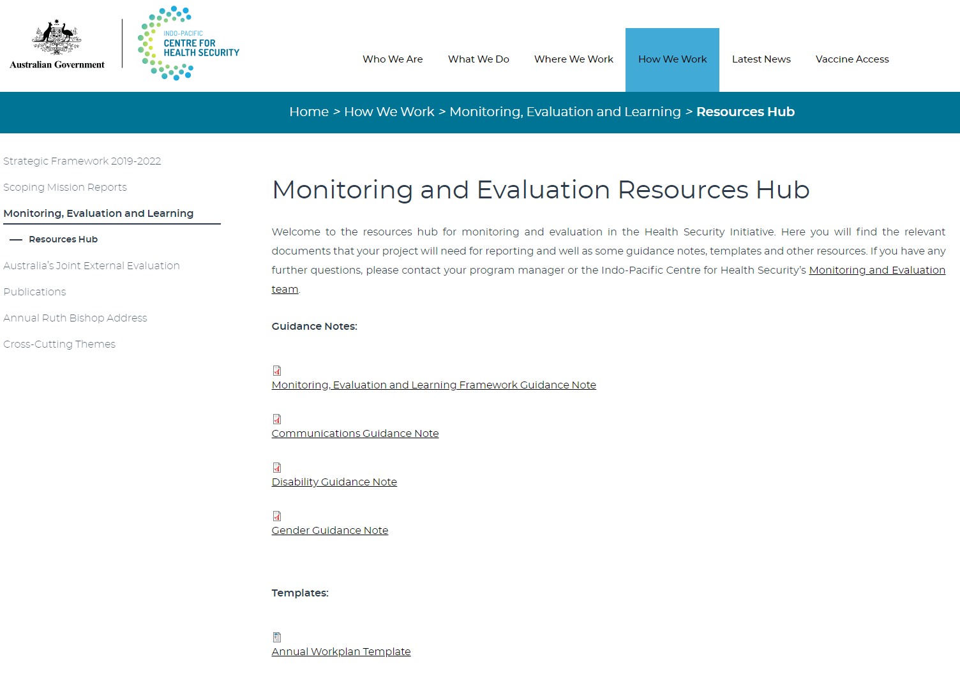
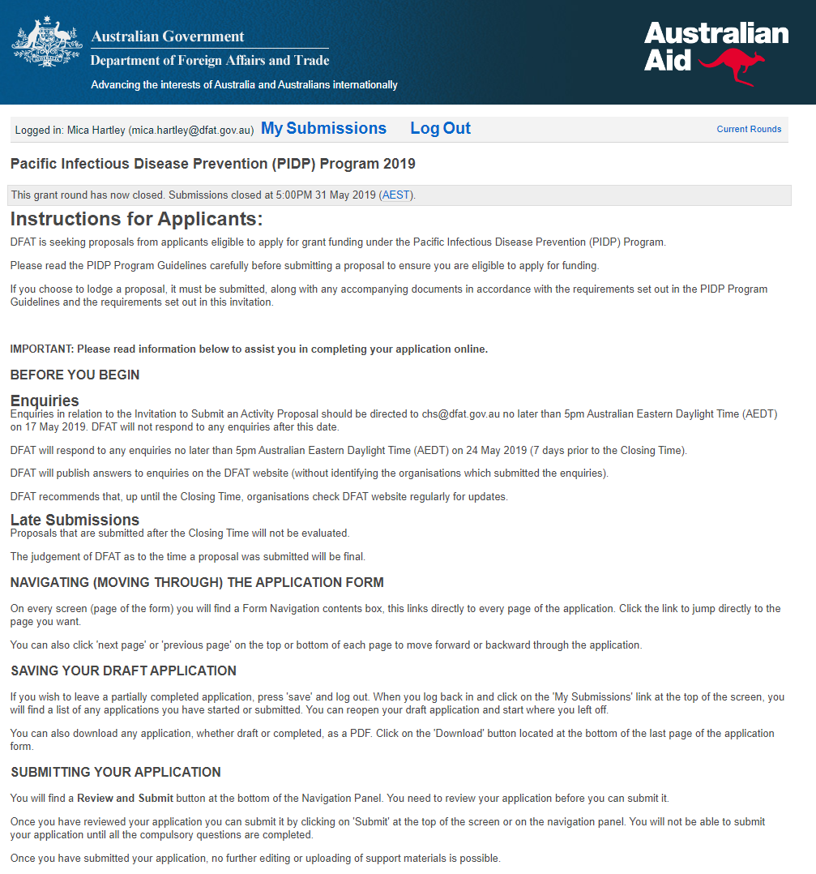
Where can I find this information?
Word versions of documents:
https://indopacifichealthsecurity.dfat.gov.au/monitoring-and-evaluation-resources-hub
“Annual Workplan Template” and “6 monthly/12 monthly Progress Report”
Link for Smartygrants Portal:
https://healthsecurity.smartygrants.com.au
Will be live on Friday, February 5 and will be on the monitoring and evaluation resources hub

Slide 12
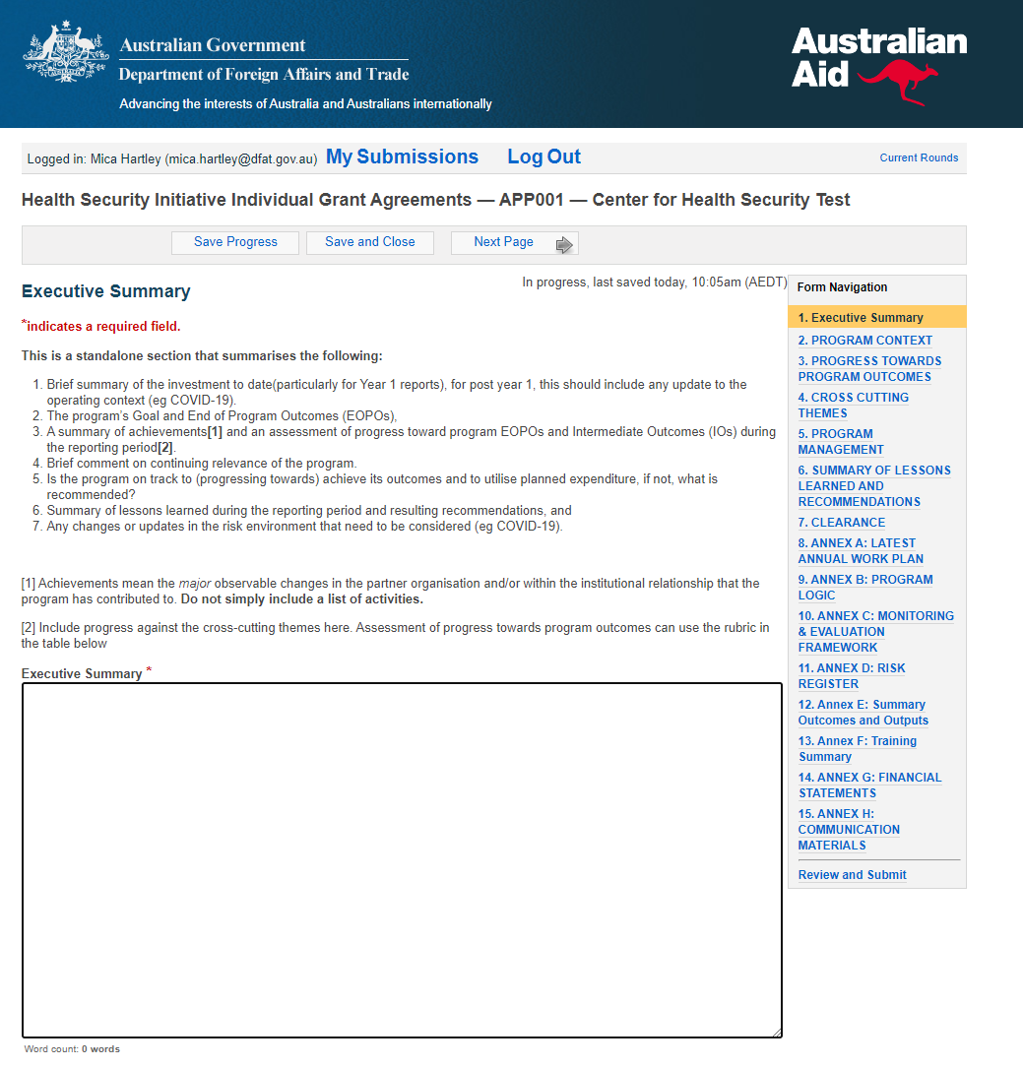
What’s in an annual progress report?
RETROSPECTIVE
Period of Feb – Jan of the previous year
Due March 17, 2021 and at the latest March 17 2022
On Smartygrants
Can look at Word version on CHS M & E hub then fill in
Comprehensive
Contains:
Narrative and Annexes –
Recommendation: complete annexes first then use annexes to complete narrative section
Executive Summary
Program Context
Progress towards Program Outcomes
This year, we ask you to reconsider end of program outcomes
Cross Cutting Themes
Expenditure and Financial Management
acquittal report to show that funds have been spent.
signed off by an internal finance officer (e.g. CFO, CEO)
Lessons learnt and Recommendations
Communications
Notes:
Advice – complete annexes first, then use what’s in annexes to complete the “narrative” part

Slide 13
What’s in an annual workplan?
PROSPECTIVE
Period of Jan – Dec of the upcoming year
Due March 17, 2021 and at the latest March 17, 2022
On Smartygrants
Can look at Word version on CHS M & E hub then fill in
Comprehensive
Contains:
Narrative and Annexes –
Recommendation: complete annexes first then use annexes to complete narrative section
Executive Summary
Context Update
Workplan
Cross Cutting Themes workplan
Planned Monitoring, Evaluation and Learning
Planned Expenditure
Planned Communications

Slide 14
What’s in an 6-monthly progress update?
RETROSPECTIVE
Period of the previous 6 months (Feb – Jul of the current year)
Due at the latest Oct 17 each year
Smartygrants
Can look at Word version on CHS M & E hub then fill in
Comprehensive
Contains:
Narrative and Annexes –
Recommendation: complete annexes first then use annexes to complete narrative section
Executive Summary
Program Context
Progress towards Program Outcomes
Cross Cutting Themes
Expenditure and Financial Management
acquittal report to show that funds have been spent.
signed off by an internal finance officer (e.g. CFO, CEO)
Lessons learnt and Recommendations
Communications

Slide 15
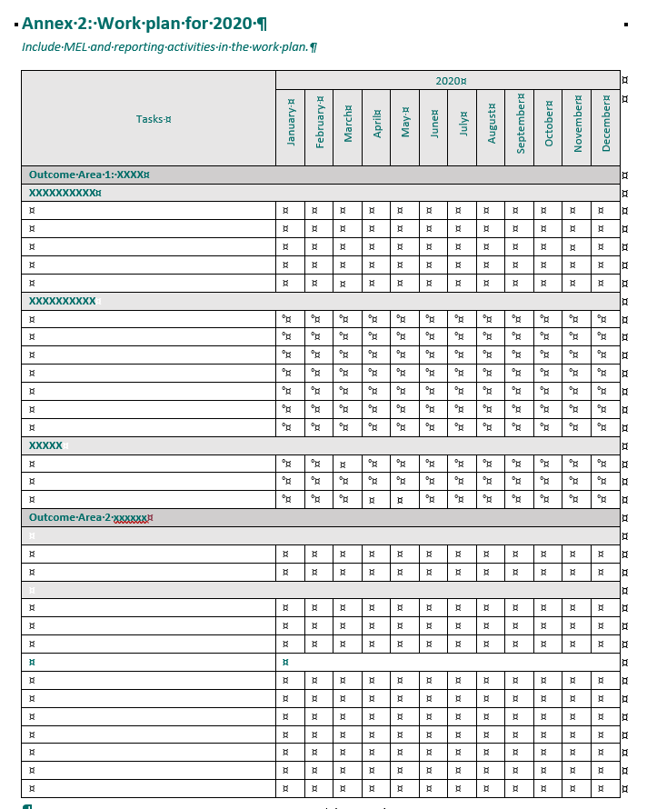
What’s in a draft workplan?
PROSPECTIVE
Period of Jan – Dec in the upcoming year
Due end Nov 2021
Paper version
Short (2-3 pages)
Takes form of “Annex 2” in the longer workplan document
Contains:
Brief description of activities planned in the next calendar year

Slide 16
What’s in a final acquittal?
Contains:
Audited financial statements, prepared by an independent auditor
Prepared by an accounting firm
Can charge this cost to the project
A certificate from the CEO or CFO
RETROSPECTIVE
Period: whole project
Due either 29 August (60 days after 30 June 2022) or 1 March, 2023 (60 days after 31 Dec 2022)
With successful no cost extension, due either 29 August (60 days after 30 June 2023) or 1 March, 2023 (60 days after 31 Dec 2023)

Slide 17
What’s in a final report?
RETROSPECTIVE
Period: whole project
Due either 29 August (60 days after 30 June 2022) or 1 March, 2023 (60 days after 31 Dec 2022)
With successful no cost extension, due either 29 August (60 days after 30 June 2023) or 1 March, 2023 (60 days after 31 Dec 2023)
On Smartygrants
Can look at Word version on CHS M & E hub then fill in
Comprehensive
Contains:
Narrative and Annexes –
Recommendation: complete annexes first then use annexes to complete narrative section
Executive Summary
Program Context
Progress towards Program Outcomes
Cross Cutting Themes
Lessons learnt and Recommendations
Communications

Slide 18
No cost extensions
We have received advice that partners are able to request no cost extensions
Up to 12 months
Encouraged to do as much as possible within original grant period
To apply: written request (email to program manager) with short (one paragraph) reason
Program manager will ask for costed proposal including
Justification
Workplan
Budget
The we will ask for internal approval (could take 1-2 months)
Not approved until this final sign off – so do not assume it will go ahead
For this reporting period, report and create a workplan as if your project is not extended

Slide 19
How do I report? Smartygrants demo

Slide 20
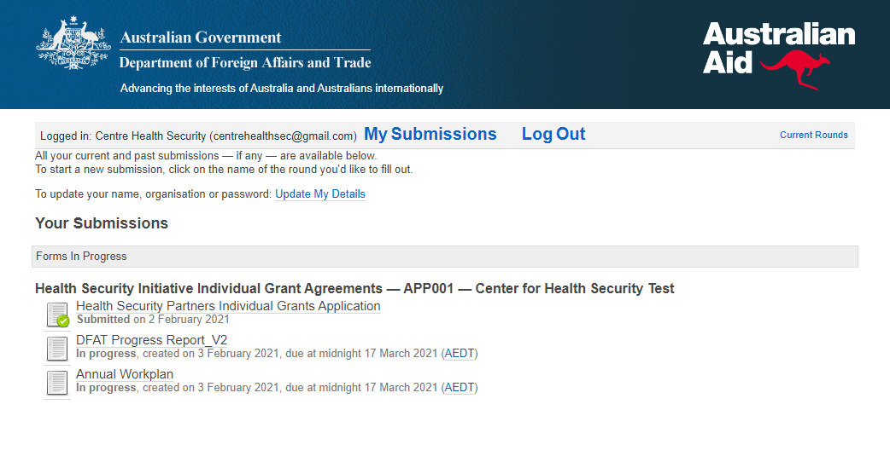
Smartygrants details
Go to https://healthsecurity.smartygrants.com.au
Email login – original login used for application
Can reset the password if needed
Can change the original email address if that
person is no longer working on the program
Go to “My Submissions”
Original application with green tick
DFAT Progress Report_V2
Annual Workplan
Word versions of these are available on the
CHS M&E Hub if you want to complete in Word
before you submit through Smartygrants

Slide 21
Recap: Key Principles of Reporting

Slide 22
Principles of Reporting
Starting point: What was the situation before my project started?
Magnitude: The size of the results compared to the magnitude of the problem (ie how many people were trained out of the total workforce – e.g. 2 nurses out of a hospital of 10 or 2 out of a hospital of 200)?
Significance: What is the significance of the result? What is the context? All results should be accompanied by qualitative, contextual information that answers the ‘so what?’ evaluative question – why is this result important to the hospital or government or country etc?
Notes:
Example: Before this project started, only 3 nurses had received training in infection prevention and control.
Example: This project trained 25 of the 30 nurses who work in AAA Hospital (85%).
Example: This is the first time nurses have received country-specific infection prevention and control training which has been an important component of AAA country’s COVID-19 response

Slide 23
Principles of Reporting
Contribution: Are the results reported due solely to my project’s efforts? Are there other contributing bodies or factors?
Outcome-level results: What are the short and medium-term effects of my project? How have the outputs of my project contributed to these changes?
Evidence: What is the evidence of change? How can I substantiate the results?
Cross-cutting themes: How has my project addressed the needs of women and/ or people with a disability? How has my project contributed to improvements in climate resilience or One Health approaches?
Notes:
Example: This project was co-funded by the AAA Donor Foundation, with DFAT providing 50% of the funding and AAA Donor providing the remaining 50%. AAA Donor also provided funding to re-surface the floor of the hospital, which further improved infection prevention and control in the hospital.
Example: This project has contributed to a decrease from 10 hospital acquired infections at AAA hospital each month to 5, and nurses reported being seen as leaders in infection prevention and control. Senior nurses also contributed to the government’s plans for repatriation flights and trained staff aboard the flights in infection prevention and control.
Example: The MOH is very supportive of the infection prevention control training program as demonstrated by their request that the project provide training in additional hospitals.
Example: Prior to commencing training, identified two nurses – one male and one female - who could lead the infection prevention and control activities in the hospital. Additional leadership training was provided to these female nurses, increasing the participation of women in leadership positions in the infection prevention and control network of the hospital.

Slide 24
Useful lessons on reporting

Slide 25
Lessons for partner reporting
Outcomes-focused information – clear evidence for achievements & project’s contribution to larger-scale change
Assessment of progress towards the end-of-project outcomes
Weave data (outputs) together to tell a clear results story for each end-of-project outcome
Cross-cutting priorities – include how you are working (process) and what has been achieved or changed (results)
Data collection – sex disaggregated data
Include program learning - what did and did not work, what needs to change, proposed management actions
Assessment of progress against work plan
Sustainability – judgement of sustainability of outcomes & planning/activities undertaken
DFAT Reporting Standards and Resources Hub (Technical Guidance Notes and Report Format)
Notes:
Outcomes-focused information – clear evidence to support stated achievements & your project’s contribution to larger-scale change
Assessment of progress towards the end of project outcomes – rubric available (each outcome)
Weave data (outputs) together to tell a clear results story for each end-of-project outcome
Cross-cutting priorities – include achievements – interested in how you are working (process) and what has been achieved or changed (results)
Data collection – sex disaggregated data
Include program learning - what did not work and/or what needs to change. Include your proposed actions(management actions) to address these.
Assessment of progress against work plan – in the report highlight any major areas where implementation differs to the work plan (can annex work plan)
Sustainability – judgement of sustainability of outcomes & planning/activities undertaken

Slide 26
Questions

Slide 27
Questions:
This is a time for us to answer the questions you have put in the chat function. There’s still time to put a number of questions in!
We would also like to hear from you (in the chat function)
What extra information would you like?
What is still unclear?
Do you have any feedback for us about previous reporting you have done?

Slide 28
Wrap-up: Next steps
Health Security Initiative Mid-Term Progress Report will be published on our website at the end of Feb (results to end of calendar year 2019)
Further questions – contact either your program managers or the Centre’s Monitoring and Evaluation team:
Irene (Irene.Wettenhall@dfat.gov.au)
Next Monitoring and Evaluation meetings:
Wednesday May 4, 3.00 and Thursday May 5, 10.00
Topic: Managing Risks in your projects – what could go wrong?
Wednesday July 6, 3.00 and Thursday, July 7, 10.00
Topic: Integrating climate resilience: guidance for project delivery

